Slide 1

ASSIGNMENT-1
Submitted To:
Niaz Ashraf Khan
Lecturer
University of Liberal Arts Bangladesh
Submitted By:
Name: Md Abul Hashem
Roll: 222014097
Course : CSE1201
Section: 2

Slide 2
Problem on Array 1
You’re given an array that contains N – 1 number of elements from 1 to N. Only one distinct integer is missing. Your task is to find out the missing integer and then print it.
Sample Input 1
N=3
N-1 Integers -> 1 3
Output: 2
Sample Input 2
N= 5
N-1 Integers -> 5 2 1 4
Output: 3
Problem on Array 2
Write a program in C to print all unique elements of an unsorted array.
Expected Output:
The given array is : 1 5 8 5 7 3 2 4 1 6 2
Unique Elements in the given array are:
1 5 8 7 3 2 4 6
Problem on Functions
Find all factors of a number by using a single function:
a) Call the function from main()
b) Store the factors in an array then print it
c) Reversely print the factors of array elements
d) Return the sum of all factors to the main

Slide 3
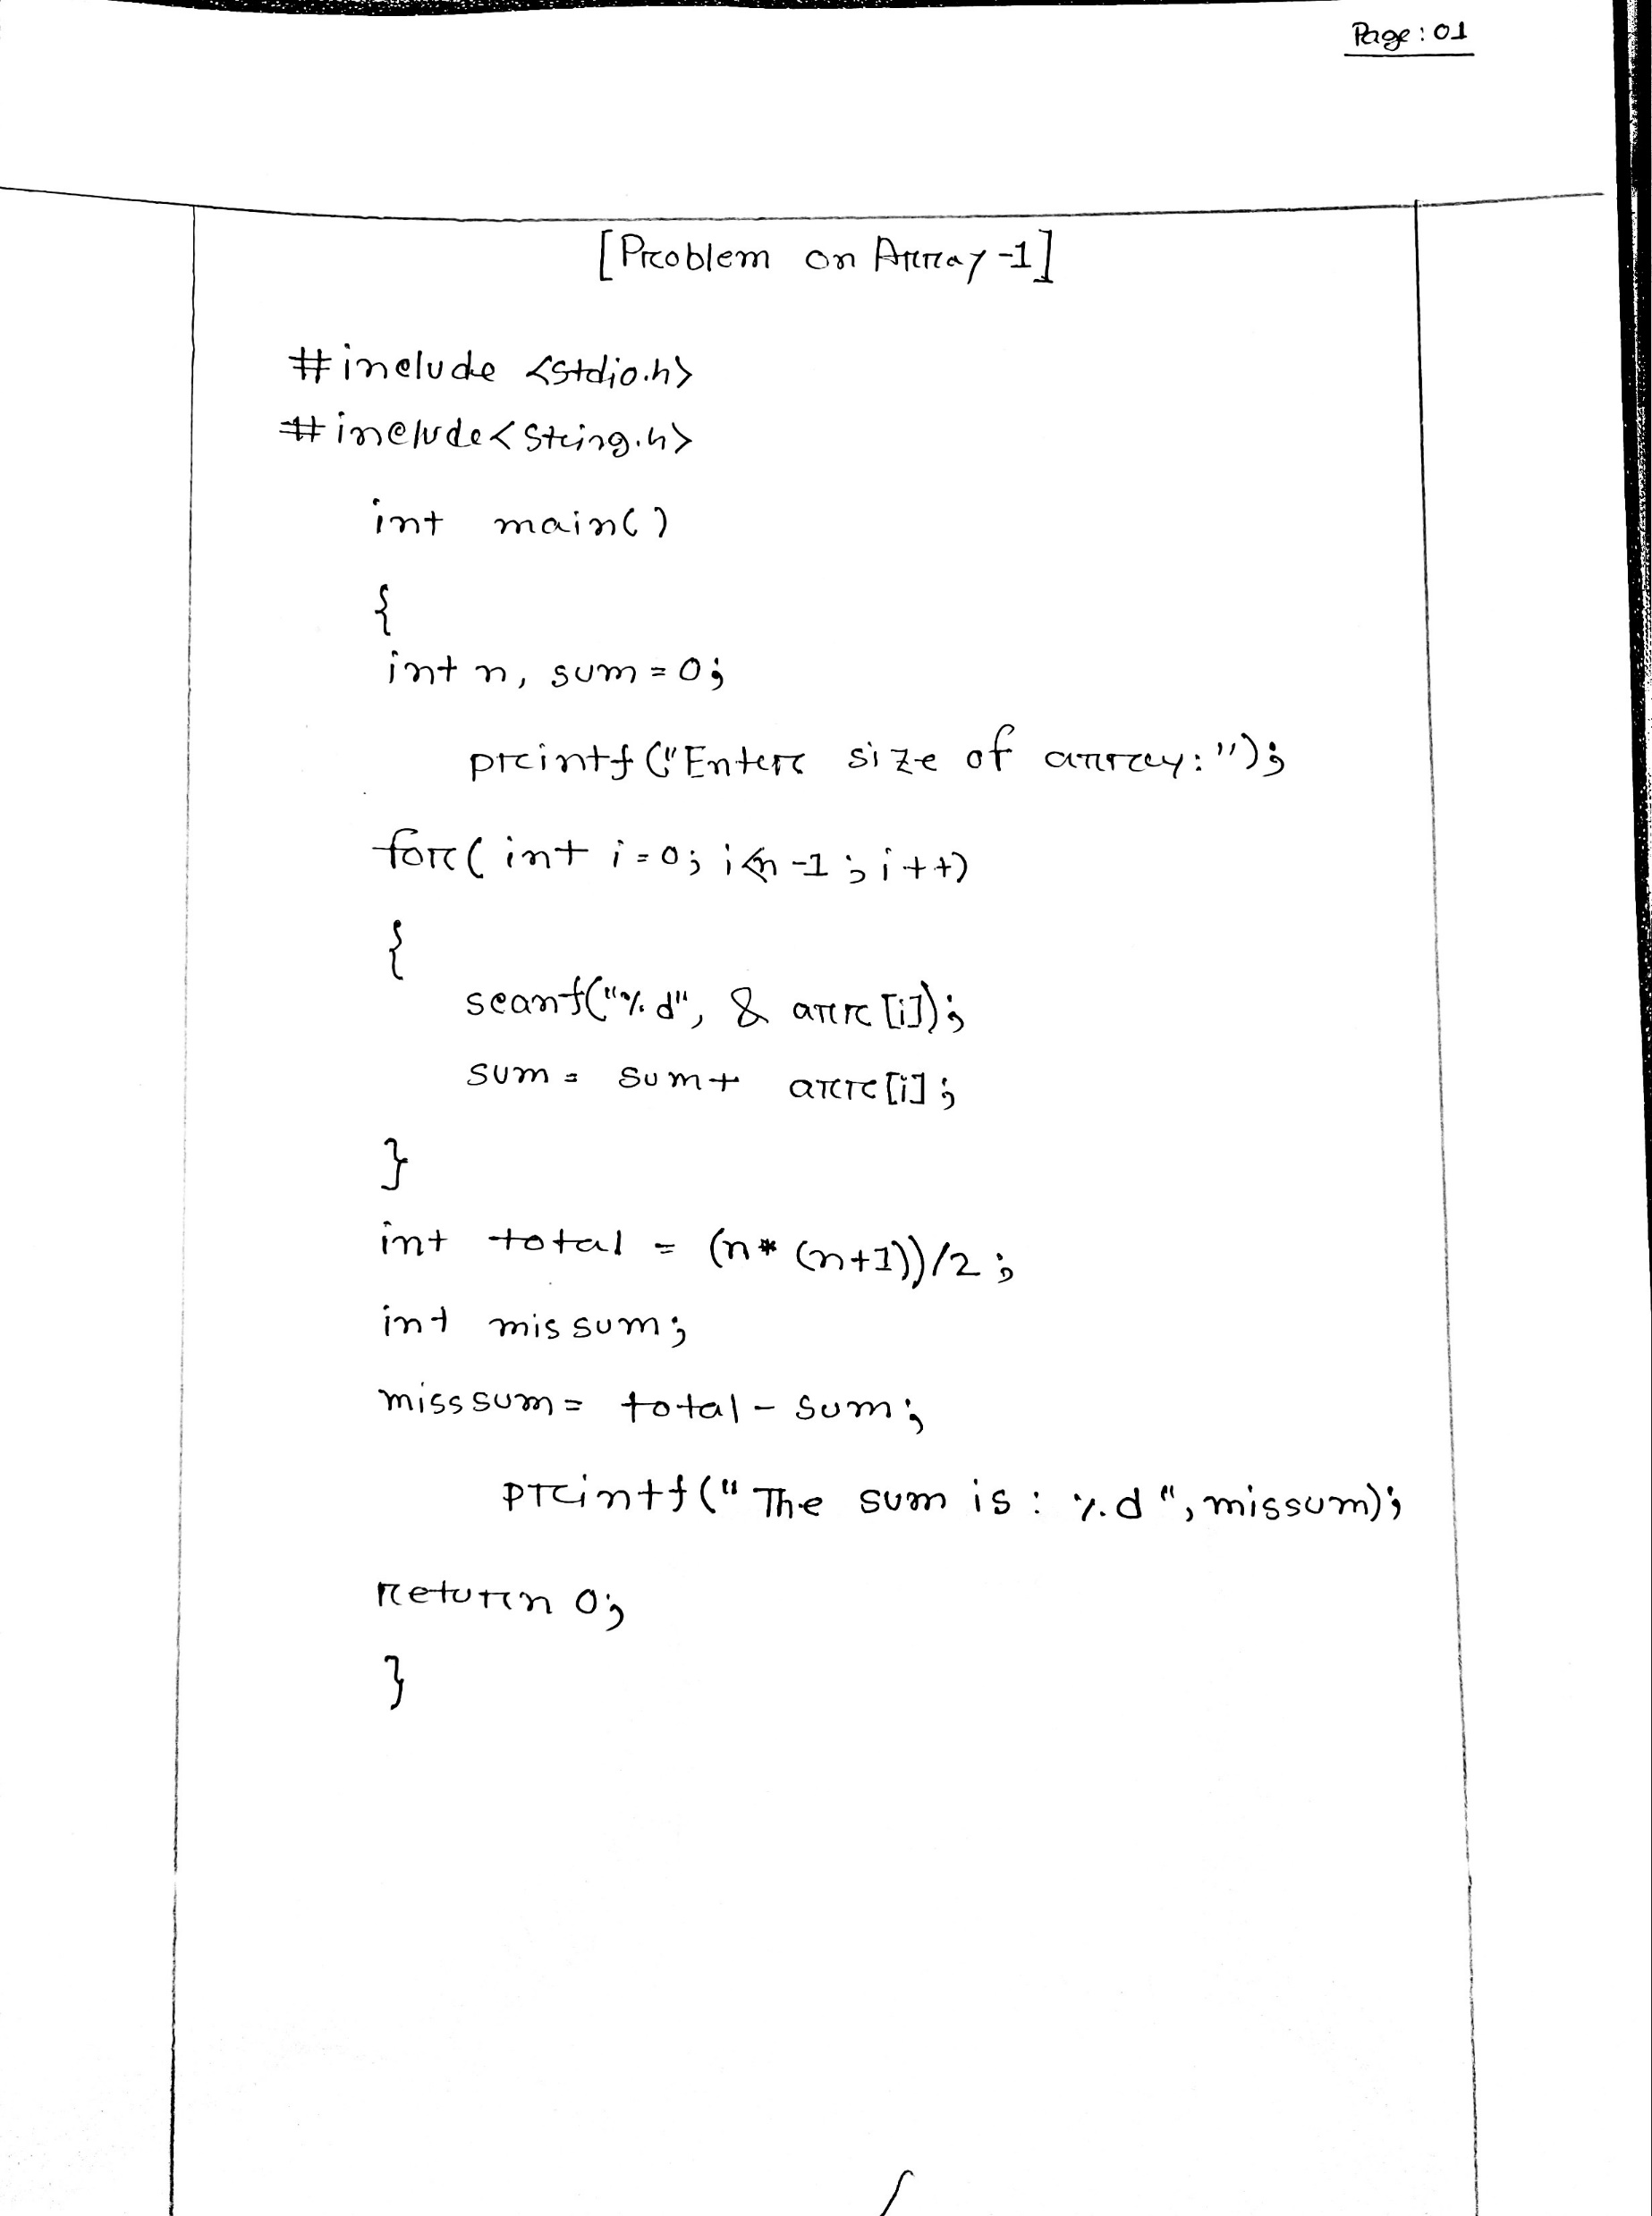

Slide 4
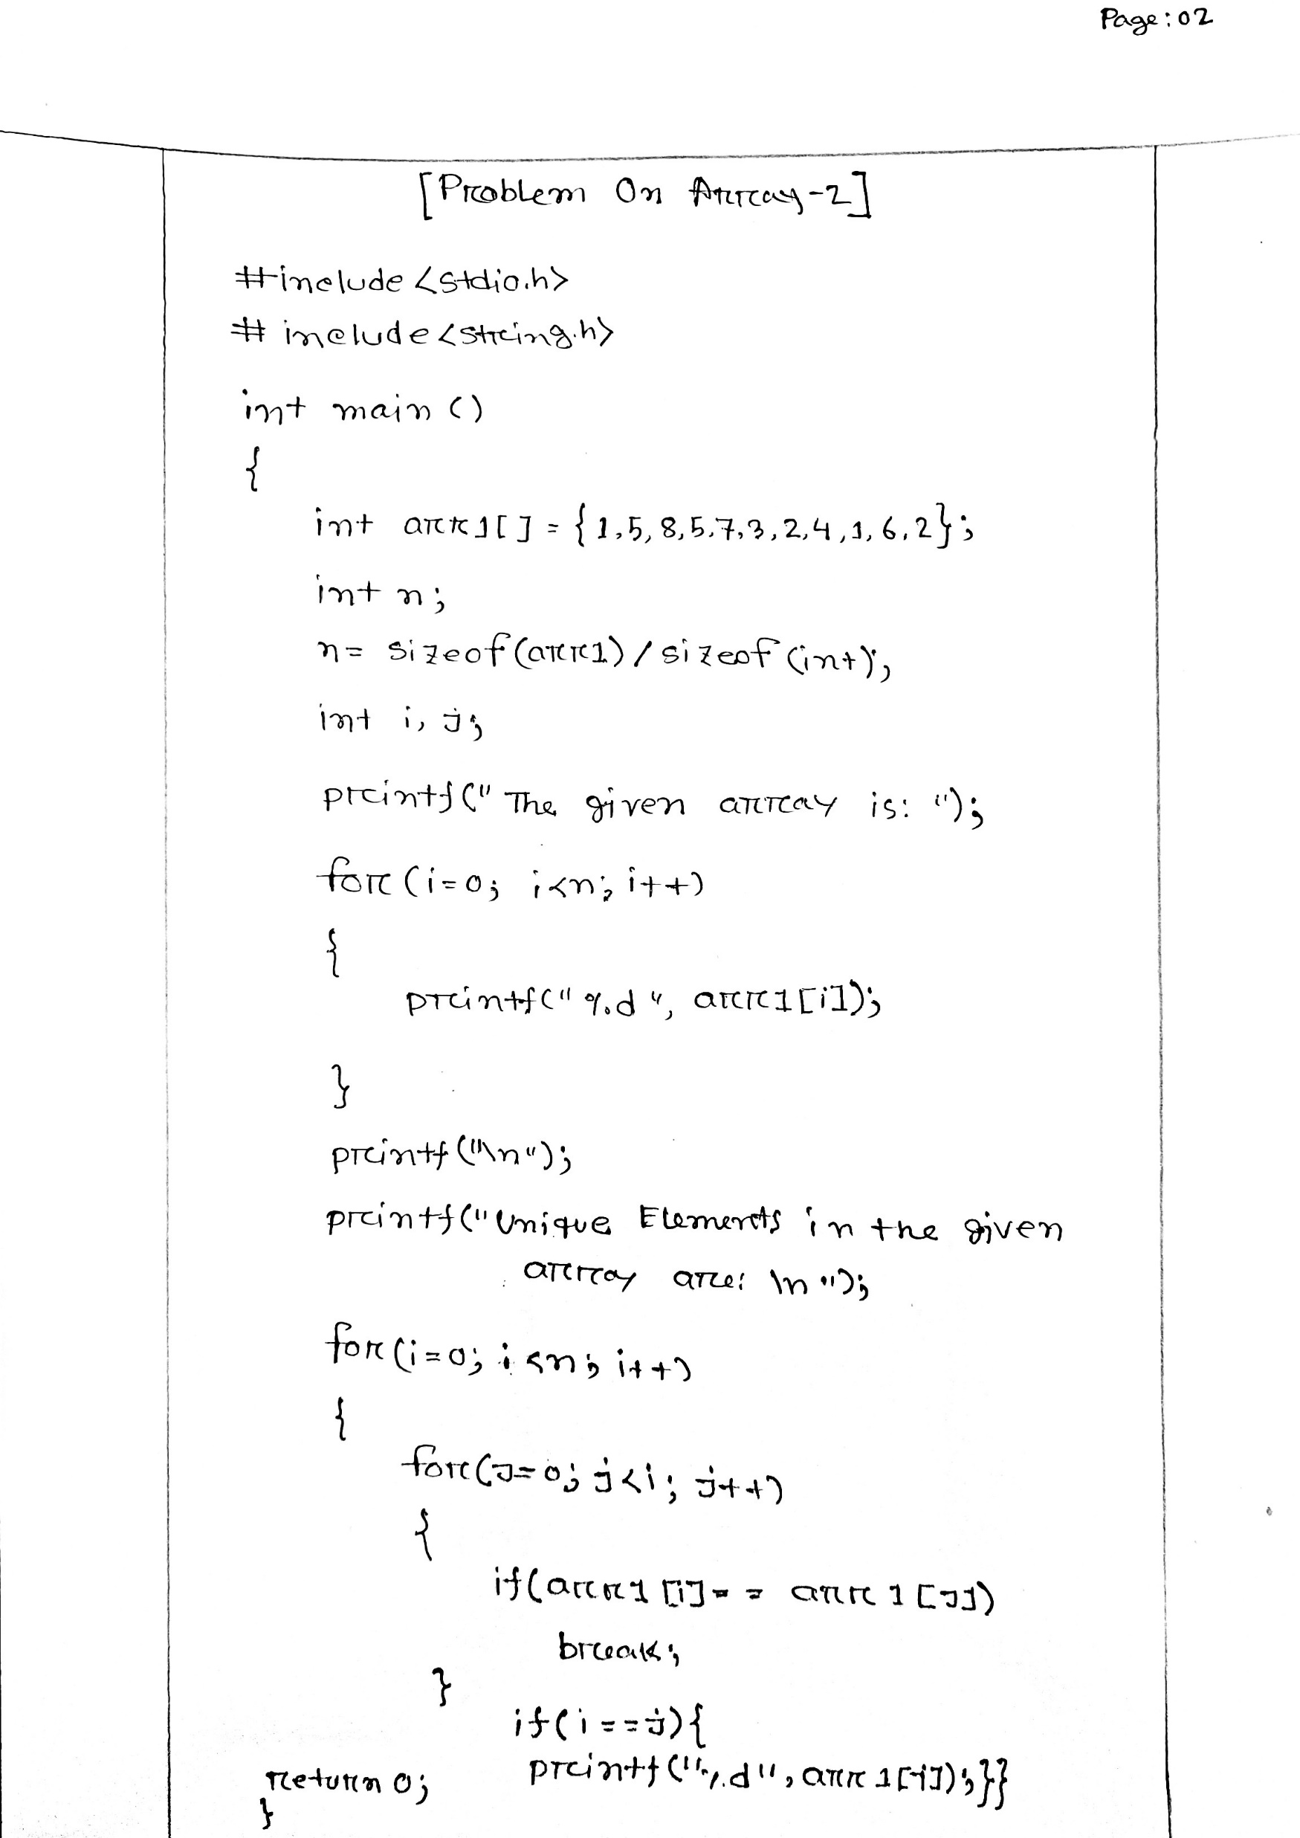

Slide 5
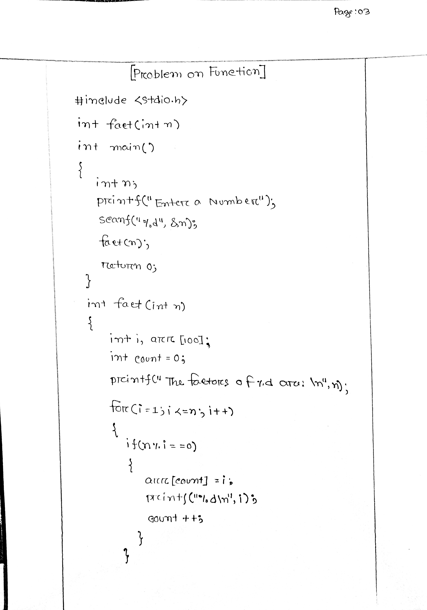

Slide 6
